Slide 1
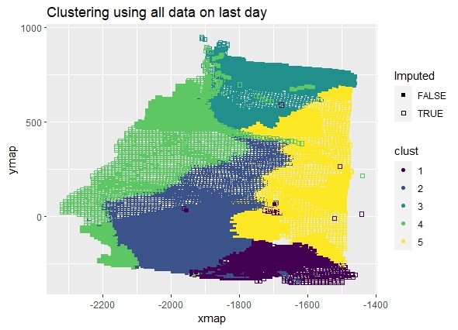
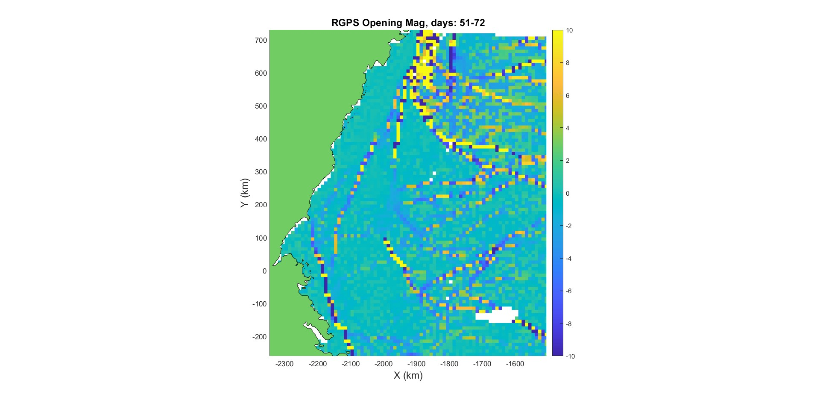
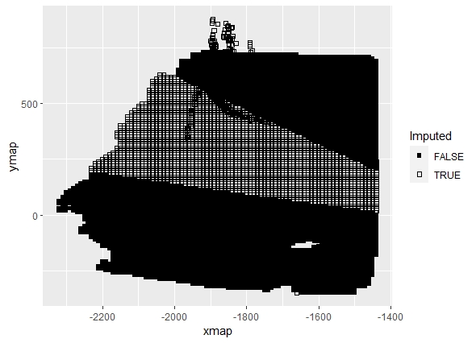
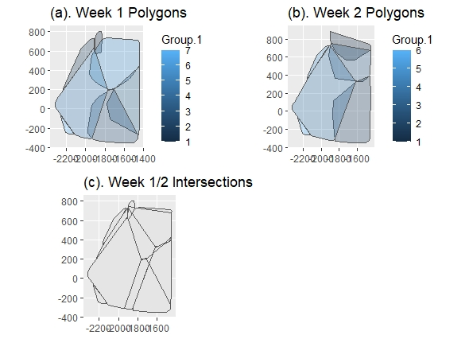
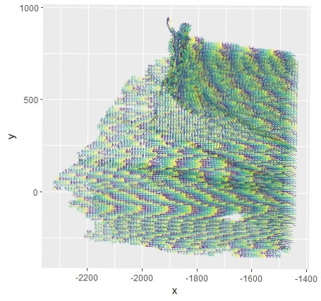
A Spatio-Temporal Model for Arctic Sea Ice
Alison Kleffner, Yawen Guan, Susan VanderPlas
Department of Statistics, University of Nebraska - Lincoln
Introduction
Sea ice is frozen water in the Arctic Ocean that generally occurs as an ice pack which can drift over the oceans surface Understanding ice dynamics plays a vital role in climate models Cracks, or leads, may form in the ice pack due to dynamic processes Allows for heat from the ocean to be transferred to the atmosphere, accounting for part of the heat flux between the ocean and the atmosphere Other Ice Lead Detection Methods Generally, involve the use of thermal images or deformation calculations found through satellite images Satellite images have drawbacks of being low in resolution and are affected by atmospheric conditions, thus may lead to inaccurate calculations
Bounding Box Clustering
Created a bounding box, made of different features, around each trajectory, to represent the movement of the trajectory over time. Features used: Length of x/y traveled (between max and min location) Difference in x/y from latest to earliest observation Angle of movement Average x/y value Can use previous information. Then used kmeans clustering, where number of clusters was determine using the silhouette width.
Results
Clustering: Interpolation: Assign 10% in desired time/intersection combination to be missing Used data in intersection from day before and day after to develop model
Intersection Interpolation
Due to the data collection method, when data is missing, it tends to be missing in chunks Method involves defining the spatio-temporal neighbors for each missing point, using our previously made clusters The overlap of a week’s clusters with the week before and after would create groups, where each member is a spatio-temporal neighbor of the others. This is because members are in a similar geographic region over time. Developed a univariate model for both x and y from the known spatio-temporal neighbors The models were created using the GpGp package in R, which uses the Vecchia’s approximation, where used the exponential space-time covariance function The output for this model is the maximum Vecchia likelihood estimates for the mean and covariance parameters. These estimates then can be used to predict the unobserved locations at that time. A grid encompassing the data was created for each time to give an initial starting point for the estimation of the missing points in the model, using the centroid of the grid cell. From this, predictions for x or y are done using the fitted model
Data
Used motion data from the RADARSTAT Geophysical Processing System (RGPS) The movement of sea ice is tracked in sequential radar images and they are usually tracked until melting season begins Due to this data collection, data may be missing due to the satellite used to obtain the SAR images not passing over part of the sea ice at a given time
RMSE for Interpolation Methods
 | Intersection Method |  | Linear Interpolation
Week | X | Y | X | Y
1 | 3.141 | 3.228 | 1.52 | 4.098
2 | 3.135 | 3.063 | 1.984 | 1.399
3 | 3.166 | 3.081 | 0.987 | 1.189
RMSE for Week 1 by Cluster
 | Intersection Method |  | Linear Interpolation
Cluster | X | Y | X | Y
1 | 3.137 | 4.276 | 3.199 | 13.042
2 | 4.364 | 4.622 | 0.187 | 0.359
3 | 2.647 | 3.139 | 1.314 | 3.066
4 | 3.006 | 2.873 | 1.396 | 2.442
5 | 3.946 | 3.561 | 0.74 | 3.036
6 | 3.109 | 3.08 | 1.876 | 5.459
Method Motivation
It can be seen in this figure that there seems to be groups movement patterns within the ice pack. Tracked identifiers in the ice sheet can be grouped together when have similar movement. This may be accomplished by using a clustering The idea is that sea ice crack may form on the border between clusters.
Conclusion
Bounding Box method is limited by pre-defined number of clusters, but seems to discover large ice leads. Should be used in conjunction with other ice lead detection methods Intersection Interpolation Method shows promise over linear interpolation when data is not linear. Some issues in model creation – like if not enough known data in that intersection for a given time.
References
QUESTIONS?
Email: akleffner@huskers.unl.edu Github Username: alisonkleffner

